Slide 2
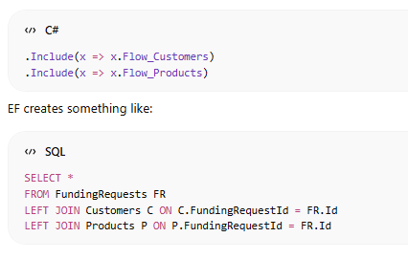
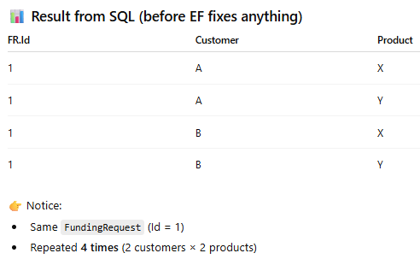
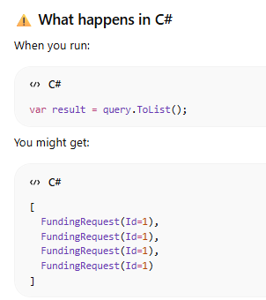
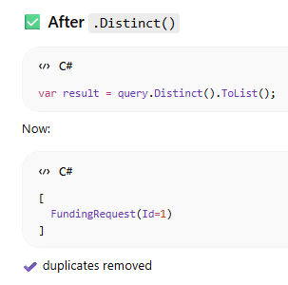
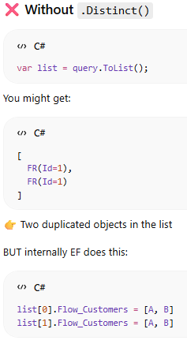
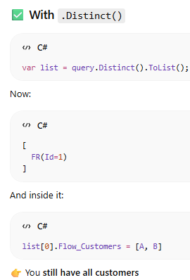
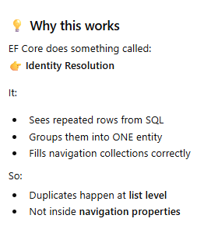
Inlcude in Linq
The problem we are going to discuss is when you include two collections navigation property
The solution is to use the distinct
The question here is “If .Distinct() removes duplicates, how do I still access multiple customers?” Distinct() does NOT remove related data (customers/products) It only removes duplicate root entities in the outer list

Slide 3
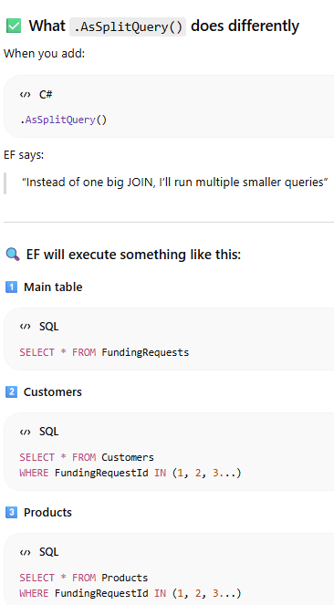
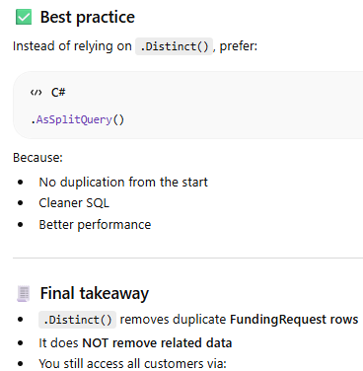
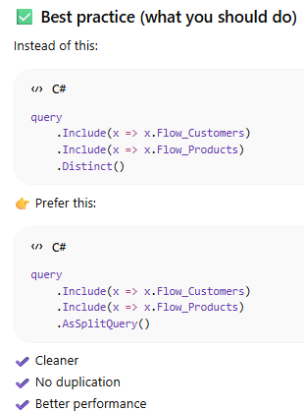
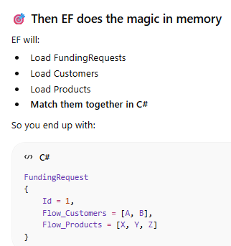
Inlcude in Linq
If you use .AsNoTracking() with distinct the EF does NOT do identity resolution
You may get duplicates
Navigation collections might not merge correctly
The solution is to use AsSplitQuery

Slide 4
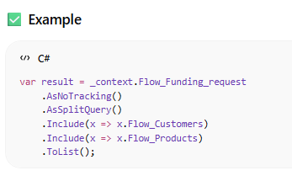
Inlcude in Linq [cont.]
✅ When you DO NOT need .Distinct()
✔ Case 1: Only one collection
✔ Case 2: Only reference navigations
✔ Case 3: using AsNoTracking
If you use .AsNoTracking() with distinct the EF does NOT do identity resolution
You may get duplicates
Navigation collections might not merge correctly
The solution is to use AsSplitQuery

Slide 5


DateTime
declare @testDate datetime = '2026-10-25 1:30:45 PM’
select @testDate [test date]
select FORMAT(@testDate, 'yyyy-MM-dd hh:mm:ss tt') AS FormattedDate;
select YEAR(@testDate) as Year -- 2026
select MONTH(@testDate) as Month -- 10
select day(@testDate) as Day -- 25
select DATEPART(YEAR, @testDate) as YEAR -- 2026
select DATEPART(MONTH, @testDate) as Month -- 10
select DATEPART(DAY, @testDate) as Day -- 25
select DATEFROMPARTS(2026, 10, 25) -- 2026-10-25
select DATETIMEFROMPARTS(2026, 10, 25, 13, 30, 45, 0) -- 2026-10-25 13:30:45.000
select ( DATENAME(MONTH, '2026-10-25’) ); -- October
select LEFT( ( DATENAME (MONTH, '2026-10-25’) ) ,3 ); -- Oct

Slide 6
DATENAME(WEEKDAY, GETDATE()) [Today] -- Monday
select CONVERT(NVARCHAR(10), GETDATE(), 103) AS ReportDate;

Slide 7
Built in methods
SPACE(1) // generate 1 space

Slide 9
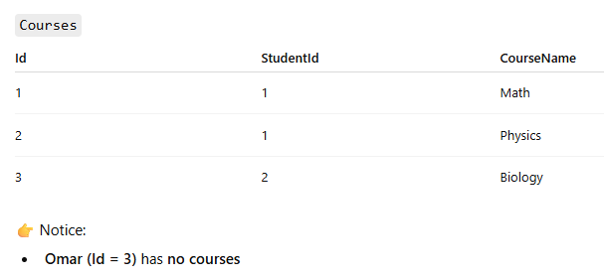
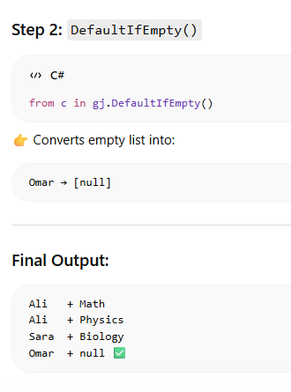
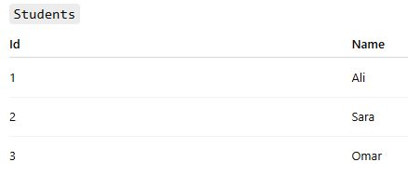
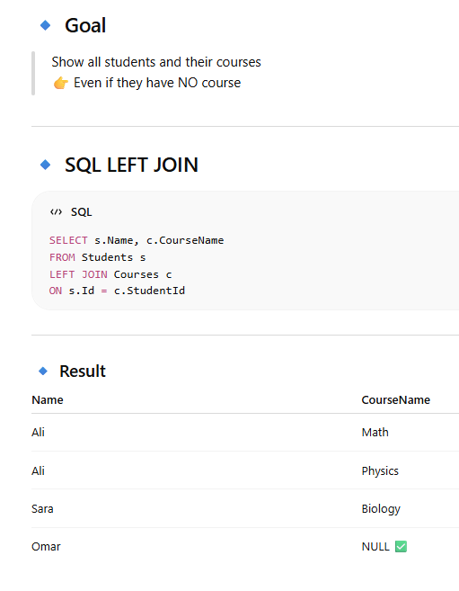
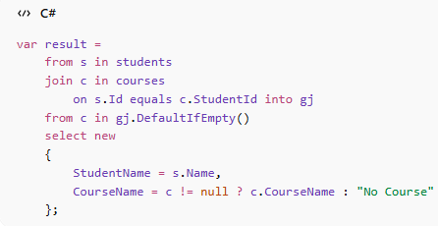
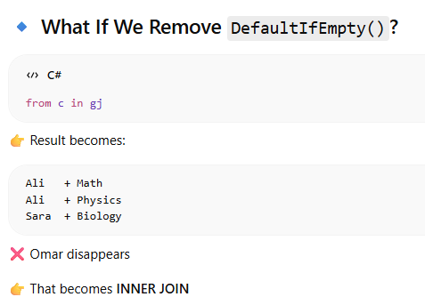
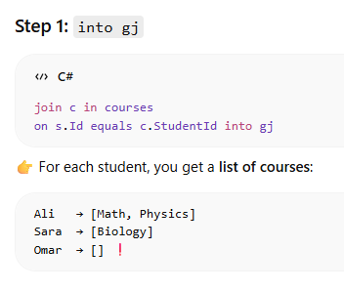
LINQ Query Syntax left Join

Slide 10
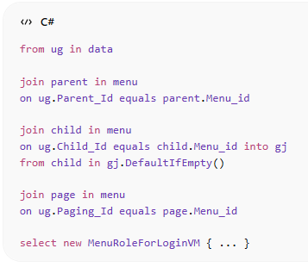
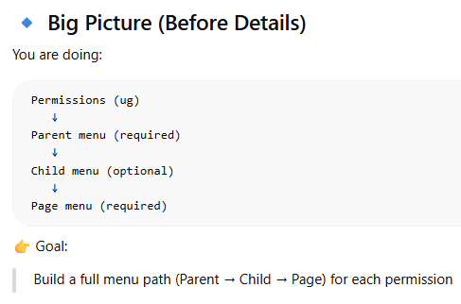
LINQ Query Syntax left Join
The tricky here is : when we need to get from all rows from first table even if there no match in second table

Slide 11
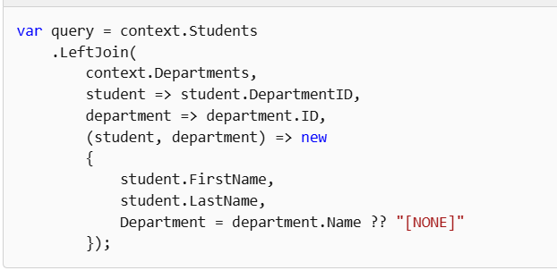
Left join in .net 10

Slide 12
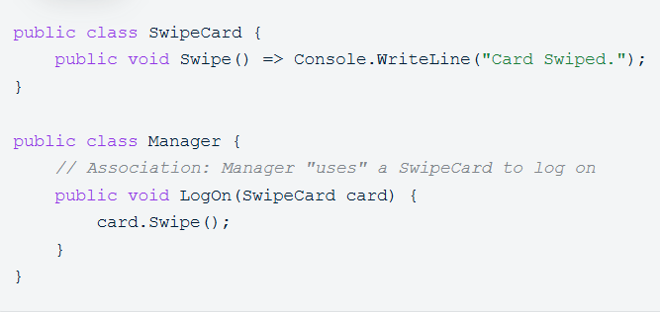
Association
Uses-A"Relationship"
It defines a link between two independent objects where they use each other to perform actions, but neither "owns" the other.
Implementation: by passing an object as a parameter to a method.

Slide 13
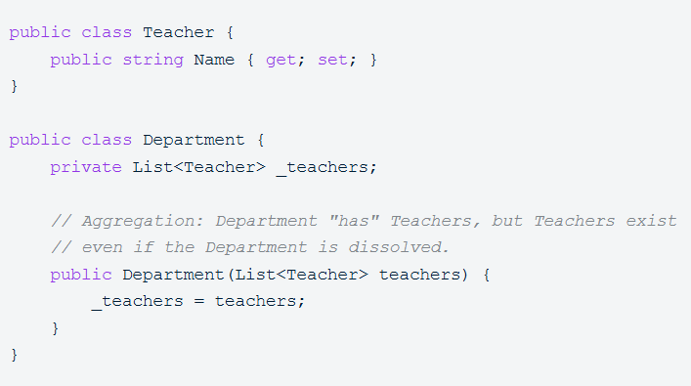
Aggregation
The "Has-A" Relationship
C# Implementation: Usually implemented by passing the child object into the parent’s constructor or property (Dependency Injection)
Here children (teachers) can live without parent [ department ]

Slide 14
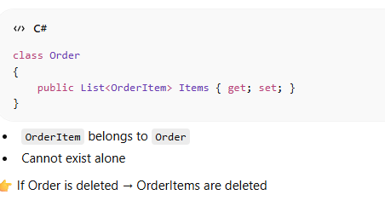
Composition
The "Part-Of" Relationship
child cannot exist without parent.

Slide 15
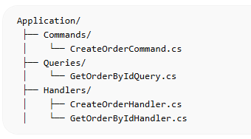
CQRS
CQRS stands for Command and Query Responsibility Segregation
It is a design pattern that separates read operations (queries) from write operations (commands).
Instead of having one model/service doing everything, CQRS splits responsibilities into two sides:
- Core Idea
- Commands → change state (Create, Update, Delete)
- Queries → read data (Get, List, Search)
-- Application
Commands
CreateOrderCommand.cs
Queries
GetOrderByIdQuery.cs
Handlers
CreateOrderHandler.cs
GetOrderByIdHandler.cs

Slide 16
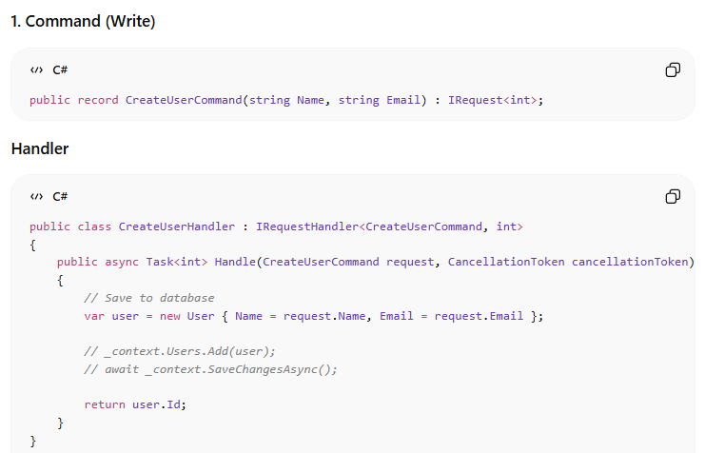
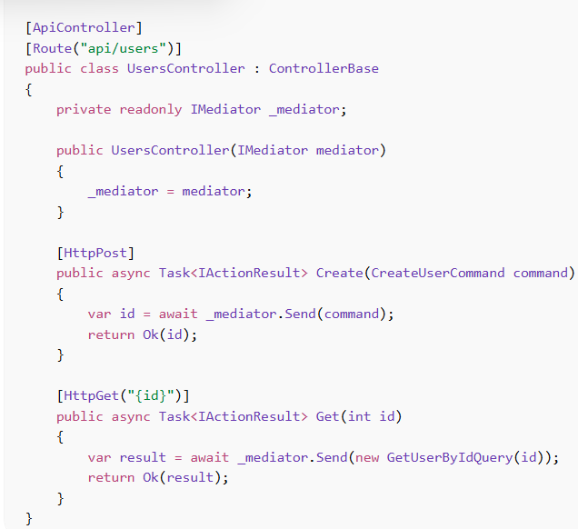
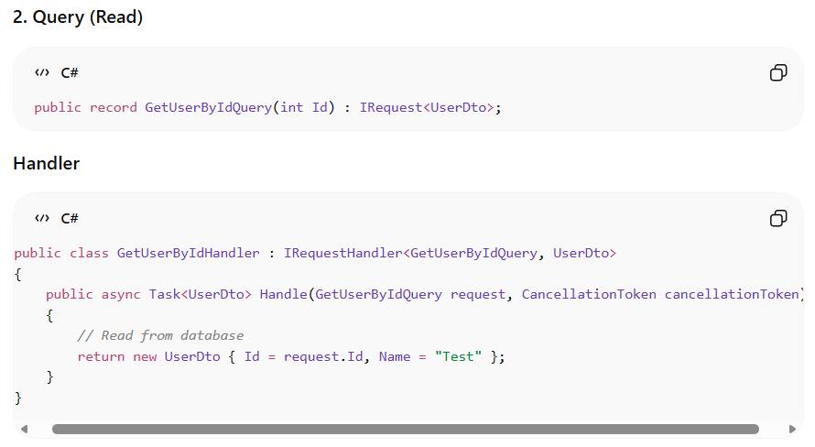
CQRS [cont.]

Slide 18
Start GIT

Slide 19
During merge conflict
If you want to keep the current version and ignore the incoming changes
git checkout --ours "Dot Net/Business.pptx“
If you want to keep the incoming version and ignore ( discard ) the local changes
git checkout --theirs "Dot Net/Business.pptx“

Slide 20
End GIT

Slide 21
Hangfire
install-package Hangfire.AspNetCore -Version 1.8.23
install-package Newtonsoft.Json 13.0.3 //
install-package Hangfire.SqlServer
Registeration
builder.Services.AddHangfire(config =>{config.UseSqlServerStorage( builder.Configuration.GetConnectionString("DefaultConnection")); });
builder.Services.AddHangfireServer();

Slide 22
Json Serializer

